Slide 1

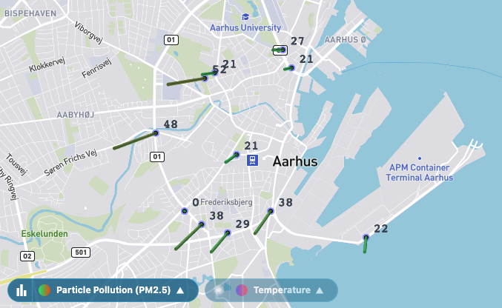
DATA ENGINEERING

Slide 2
Agenda - CRUD
SQL
Hvorfor SQL?
Intro til Dbeaver
World – hent sql og ind i workbench
World – start-demo
SELECT (conditions,join,aggregation)
WORLD-databasen
struktur
Øvelser i MySQL
Northwind
struktur
øvelser
UPDATE og INSERT (Northwind)
Demo
Øvelser

Slide 3
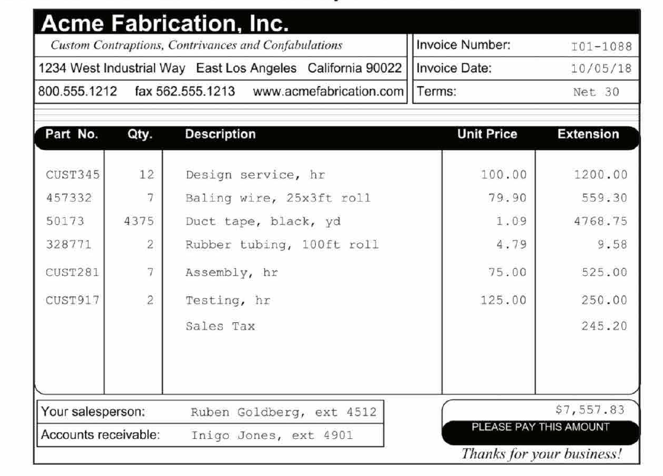
MySQL Design case – From invoice to schema

Slide 4
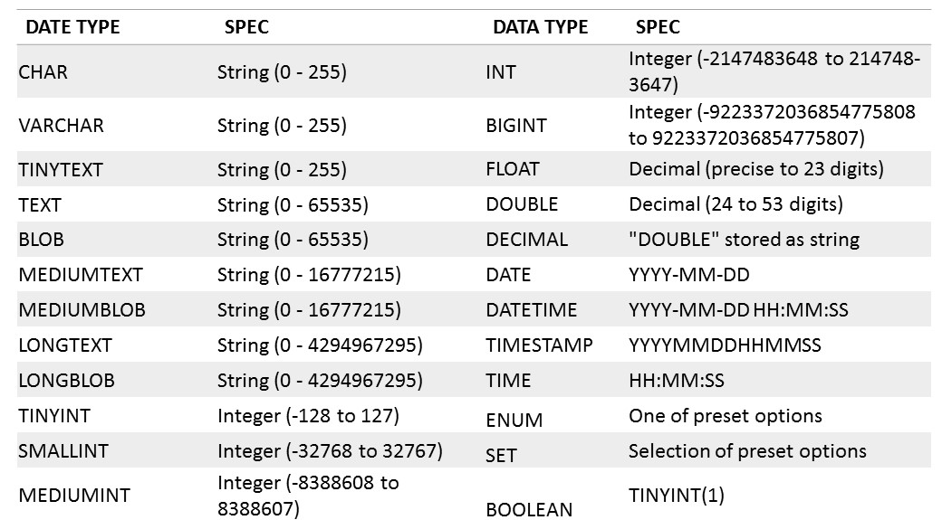
MySQL Design - From invoice to schema - Identify datatypes

Slide 5
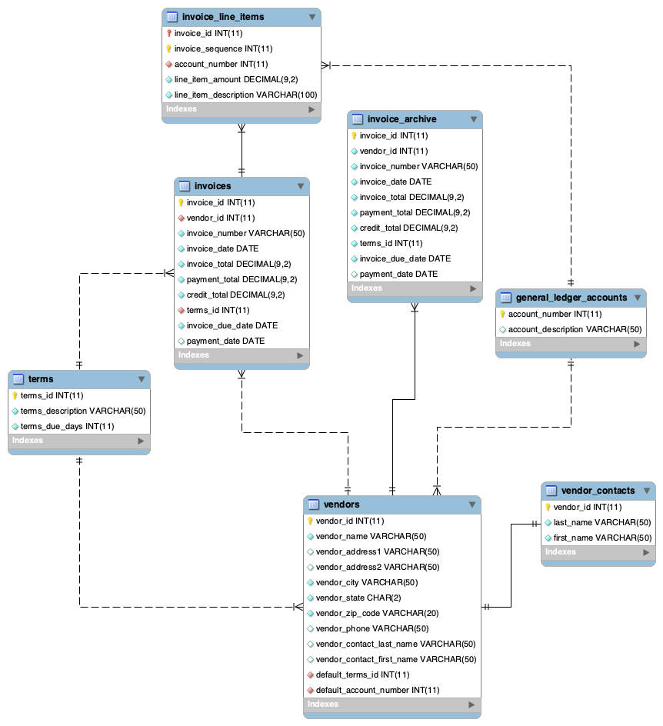
MySQL Design - From invoice to schema – Final ER-diagram

Slide 6
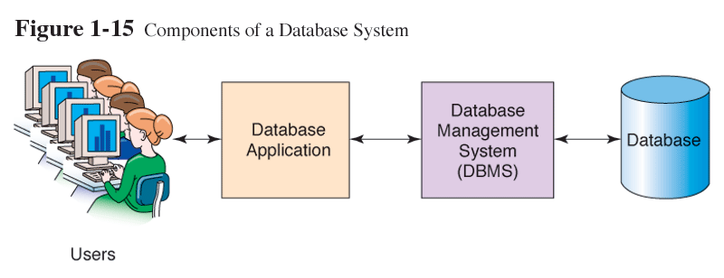
Database Management System (DBMS)
Et software system som giver brugere mulighed for at definere, oprette og vedligeholde en database samt kontrolleret adgang til denne.

Slide 7
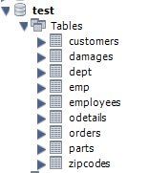
Relationel Database
Den mest udbredte DBMS type.
En database har et navn
En database har en eller flere tabeller
Hver tabel har et navn
Hver tabel har en eller flere kolonner
Hver kolonne har navn og datatype
Eksempel:
Database hedder test indeholder 9 tabeller

Slide 8
A relational database consists of tables. Tables consist of rows and columns, which can also be referred to as records and fields.
A table is typically modeled after a real-world entity, such as an invoice or a vendor.
A column represents some attribute of the entity, such as the amount of an invoice or a vendor's address.
A row contains a set of values for a single instance of the entity, such as one invoice or one vendor.
The intersection of a row and a column is sometimes called a cell. A cell stores a single value.
Most tables have a primary key that uniquely identifies each row in the table. The primary key is usually a single column, but it can also consist of two or more columns. If a primary key uses two or more columns, it's called a composite primary key.
A table can also be defined with one or more indexes. An index provides an efficient way to access data from a table based on the values in specific columns. An index is automatically created for a table's primary and non-primary keys.

Slide 9
Tabel eksempel Medarbejdere (emp)
Kolonner – har navn og simpel datatype
empno | ename | job | mgr | hiredate | sal | deptno
7369 | SMITH | CLERK | 7902 | 12/17/1980 | 800 | 20
7499 | ALLEN | SALESMAN | 7698 | 02/20/1981 | 1600 | 30
7521 | WARD | SALESMAN | 7698 | 02/22/1981 | 1250 | 30
7566 | JONES | MANAGER | 7839 | 04-02-1981 | 2975 | 20
7654 | MARTIN | SALESMAN | 7698 | 09/28/1981 | 1250 | 30
7698 | BLAKE | MANAGER | 7839 | 05-01-1981 | 2850 | 30
7782 | CLARK | MANAGER | 7839 | 06-09-1981 | 2450 | 10
7788 | SCOTT | ANALYST | 7566 | 04/19/1987 | 3000 | 20
7839 | KING | PRESIDENT |  | 11/17/1981 | 5000 | 10
7844 | TURNER | SALESMAN | 7698 | 09-08-1981 | 1500 | 30
7876 | ADAMS | CLERK | 7788 | 05/23/1987 | 1100 | 20
7900 | JAMES | CLERK | 7698 | 12-03-1981 | 950 | 30
7902 | FORD | ANALYST | 7566 | 12-03-1981 | 3000 | 20
7934 | MILLER | CLERK | 7782 | 01/23/1982 | 1300 | 10
Rækker
– indeholder relaterede værdier

Slide 10
Tabel eksempel 2 Medarbejdere (emp) Afdelinger (dept)
emp
dept
empno | ename | job | mgr | hiredate | sal | deptno
7369 | SMITH | CLERK | 7902 | 12/17/1980 | 800 | 20
7499 | ALLEN | SALESMAN | 7698 | 02/20/1981 | 1600 | 30
7521 | WARD | SALESMAN | 7698 | 02/22/1981 | 1250 | 30
7566 | JONES | MANAGER | 7839 | 04-02-1981 | 2975 | 20
7654 | MARTIN | SALESMAN | 7698 | 09/28/1981 | 1250 | 30
7698 | BLAKE | MANAGER | 7839 | 05-01-1981 | 2850 | 30
7782 | CLARK | MANAGER | 7839 | 06-09-1981 | 2450 | 10
7788 | SCOTT | ANALYST | 7566 | 04/19/1987 | 3000 | 20
7839 | KING | PRESIDENT |  | 11/17/1981 | 5000 | 10
7844 | TURNER | SALESMAN | 7698 | 09-08-1981 | 1500 | 30
7876 | ADAMS | CLERK | 7788 | 05/23/1987 | 1100 | 20
7900 | JAMES | CLERK | 7698 | 12-03-1981 | 950 | 30
7902 | FORD | ANALYST | 7566 | 12-03-1981 | 3000 | 20
7934 | MILLER | CLERK | 7782 | 01/23/1982 | 1300 | 10
deptno | dname | loc
10 | ACCOUNTING | NEW YORK
20 | RESEARCH | DALLAS
30 | SALES | CHICAGO
40 | OPERATIONS | BOSTON
Er tabellerne
logisk forbundne?

Slide 11
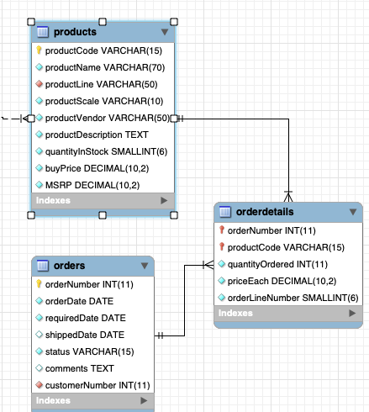
The tables in a database can be related to other tables by values in specific columns. The two tables shown in figure 1-5 illustrate this concept. Here, each row in the Employeestable is related to one or more rows in the Customers table. This is called a one-to-many relationship. Typically, relationships exist between the primary key in one table and the foreign key in another table. The foreign key is simply one or more columns in a table that refer to a primary key in another table. In this figure, for example, the salesrepemployeenumber column is the foreign key in the Customers table and is used to create the relationship between the Employess table and the customers table.
In contrast, a many-to-many relationship is usually implemented by using an intermediate table that has a one-to-many relationship with the two tables in the many-to-many relationship. In other words, a many-to-many relationship can
usually be broken down into two one-to-many relationships.
If you define a foreign key for a table in MySQL, you can have the foreign key enforce referential integrity. When MySQL enforces referential integrity, it makes sure that any changes to the data in the database don't create invalid relationships between tables. This helps to maintain the integrity
of the data that's stored in the database.

Slide 12
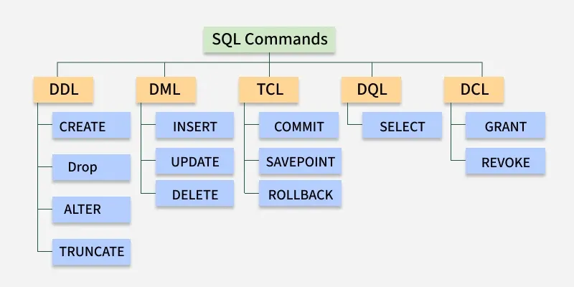
SQL – flere formål

Slide 13
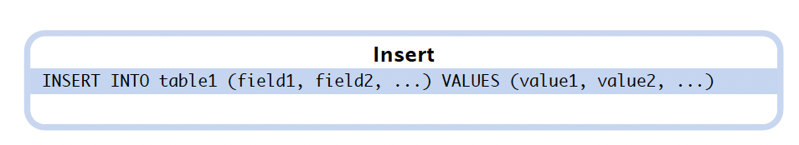
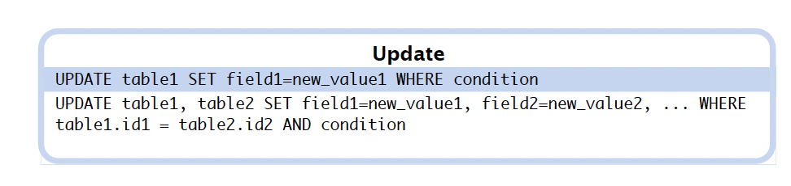
SQL
Data Definition (DDL)
CREATE
ALTER
DROP
Data Manipulation
(DML)
INSERT
UPDATE
DELETE
Data Retrieval
(DQL)
SELECT
Indsæt ”Gravel Ost” i produkttabellen
Sæt ”Gravel Ost” til at være udgået

Slide 14
SQL – flere formål
DML (Data Manipulation Language)
Kommandoer som ændrer data i databasen
DDL (Data Definition Language)
Kommandoer som definerer databasen
Database forespørgsler har formatet: Eksempel:
select …
from …
where …
select ename
from emp
where mgr = 7698

Slide 15
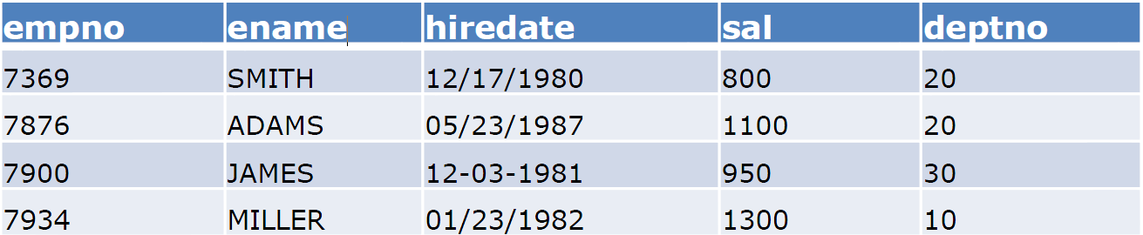
SQL SELECT eksempler
SELECT *
FROM emp
SELECT avg(sal)
FROM emp
SELECT ename, hiredate, sal
FROM emp
WHERE sal > 1000
SELECT empno
FROM emp
WHERE ename = 'Smith'
Notes:
(OBS! Brug ' når der søges på tekst)

Slide 16
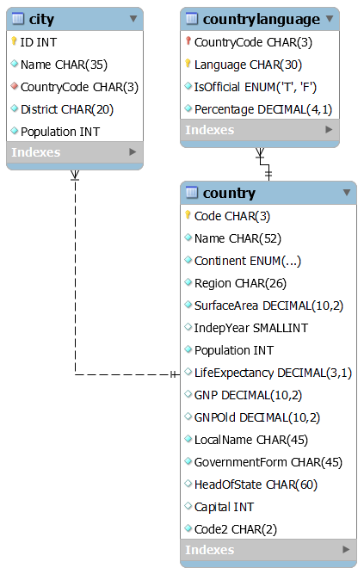
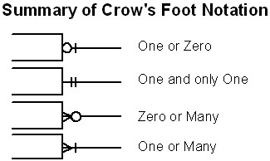
World DB ER-diagram
howto: Reverse engineer in WorkBench
Notes:
(OBS! Brug ' når der søges på tekst)

Slide 17
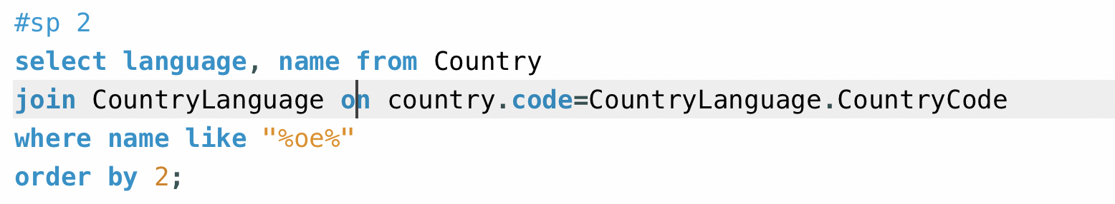
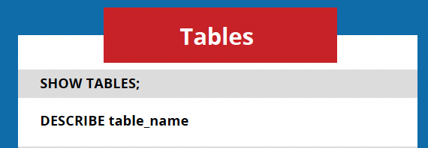
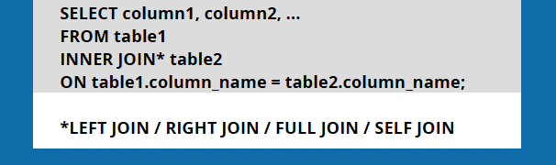
World DB - Joins
I hvilket distrikt ligger byen 'Stanley’?
2) Er færøsk et officielt sprog på Færøerne?
Notes:
(OBS! Brug ' når der søges på tekst)

Slide 18
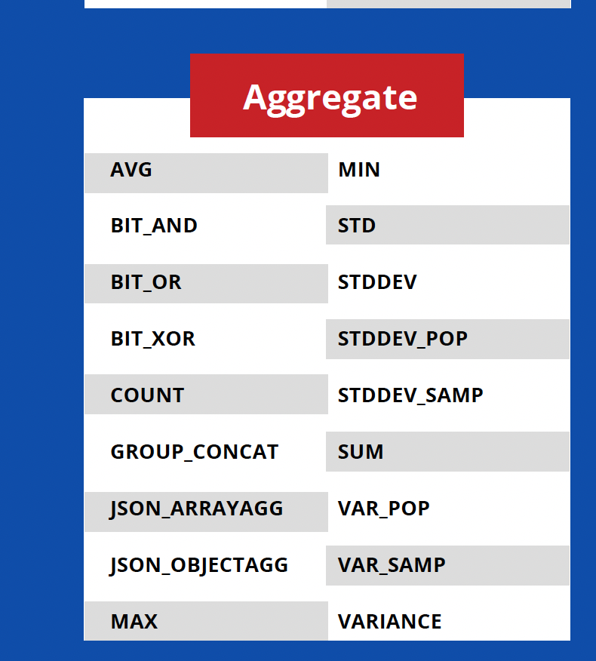
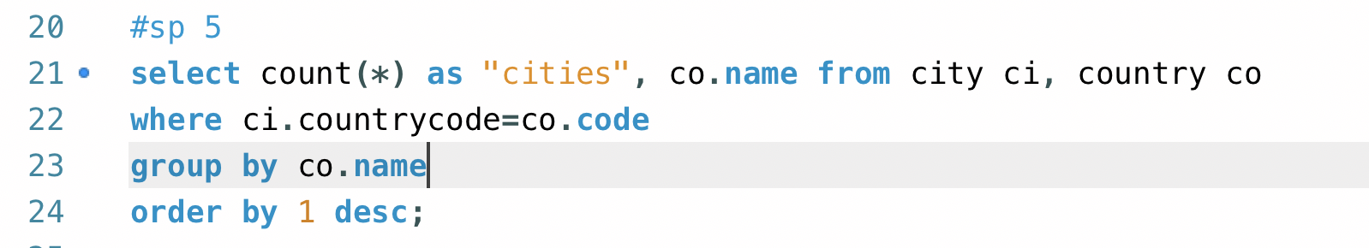
World DB - Aggregation
5) Hvor mange amerikanske byer er med i DB'en?
Notes:
(OBS! Brug ' når der søges på tekst)

Slide 19
World DB select
I hvilket distrikt ligger byen 'Stanley’?
2) Er færøsk et officielt sprog på Færøerne?
3) Hvad er `CountryCode` for 'Sri Lanka'
4) Hvilket land har det mindste areal?
5) Hvor mange amerikanske byer er med i DB'en?
6) I hvilket land taler mere end halvdelen af befolkningen 'Pashto'?
7) Hvad er den samlede befolkning i de danske byer der er med i DB'en?
8) Hvilke sprog tales i byen 'Nassau'?
9) Hvilket land har den højeste `LifeExpectancy`?
10) Hvilke lande har flere indbyggere end Russland?
Notes:
(OBS! Brug ' når der søges på tekst)

Slide 20
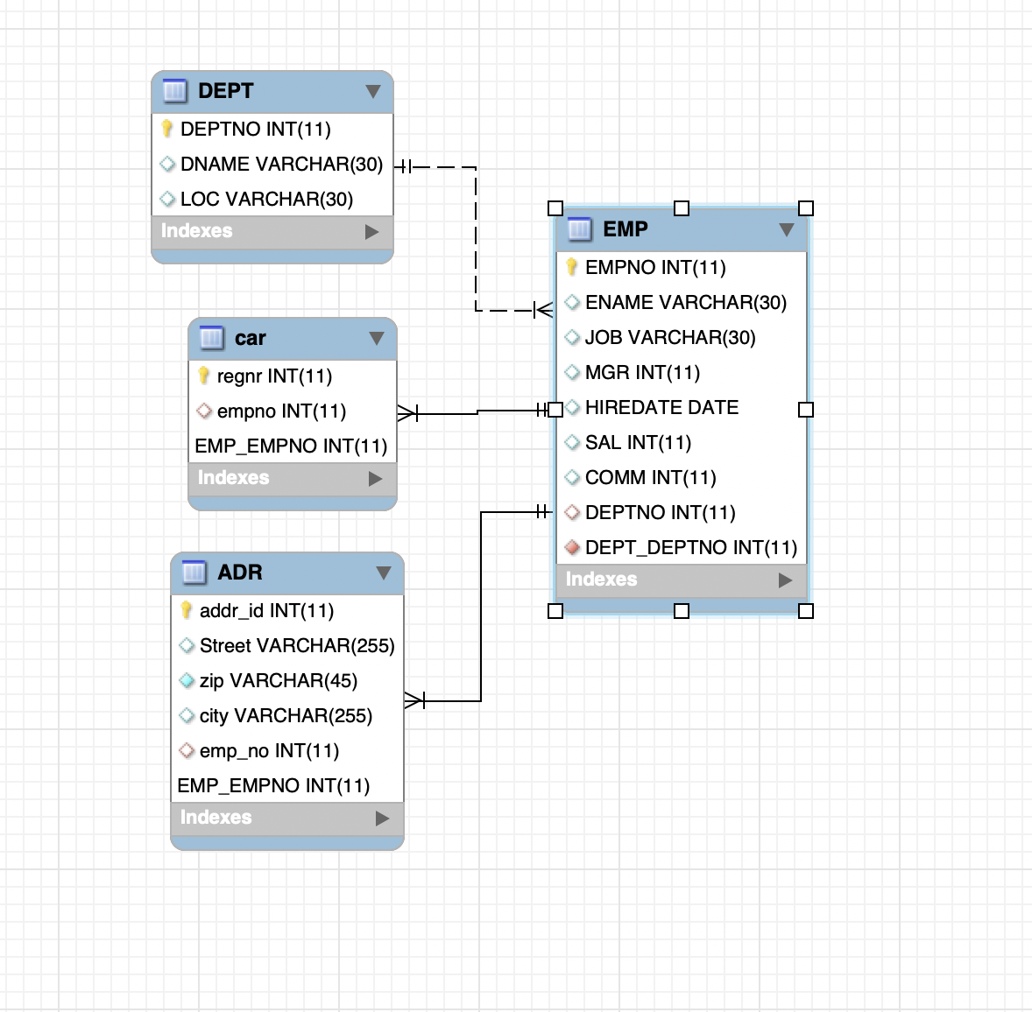
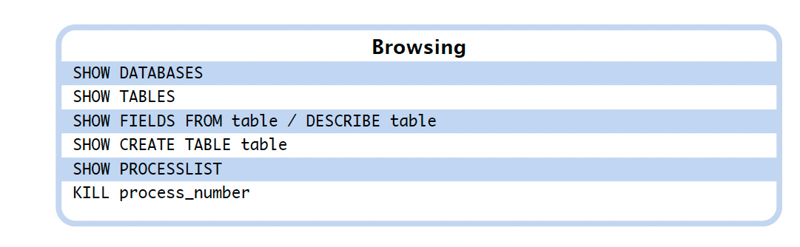
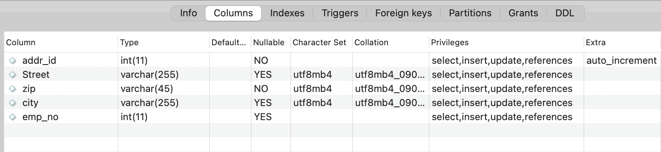
MySQL Skema

Slide 21
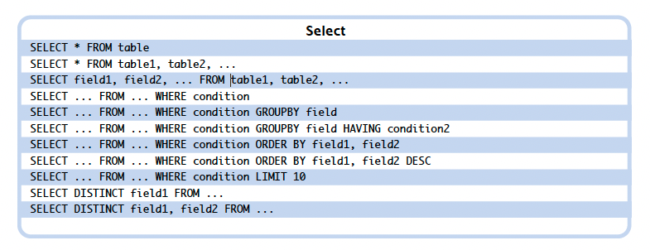
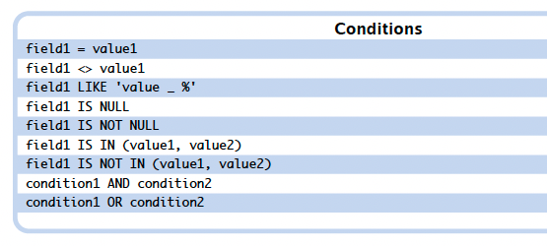
Mysql – Filtre

Slide 22
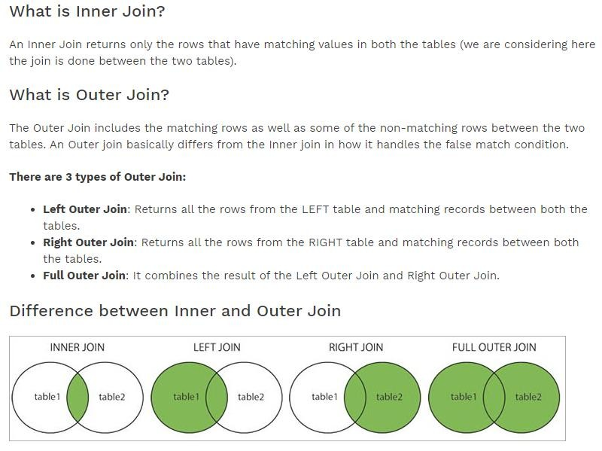
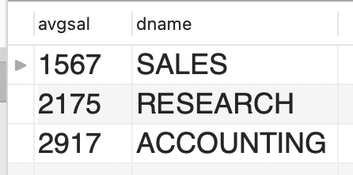
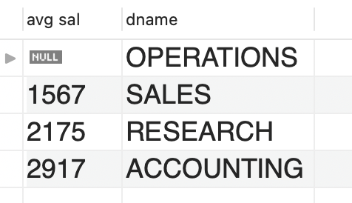
https://www.softwaretestinghelp.com/inner-join-vs-outer-join/

Slide 23
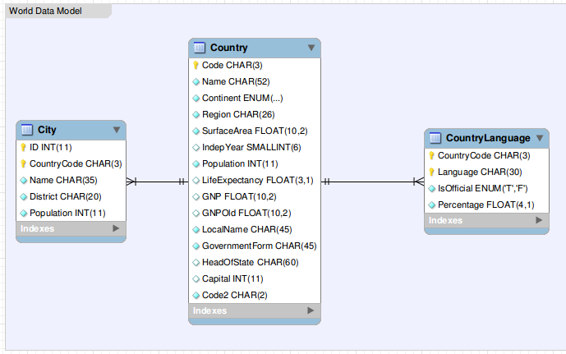
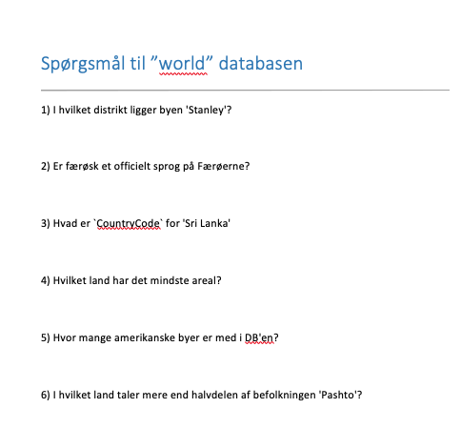
WORLD Databasen

Slide 24
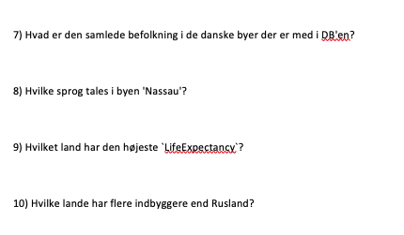
WORLD Databasen

Slide 25
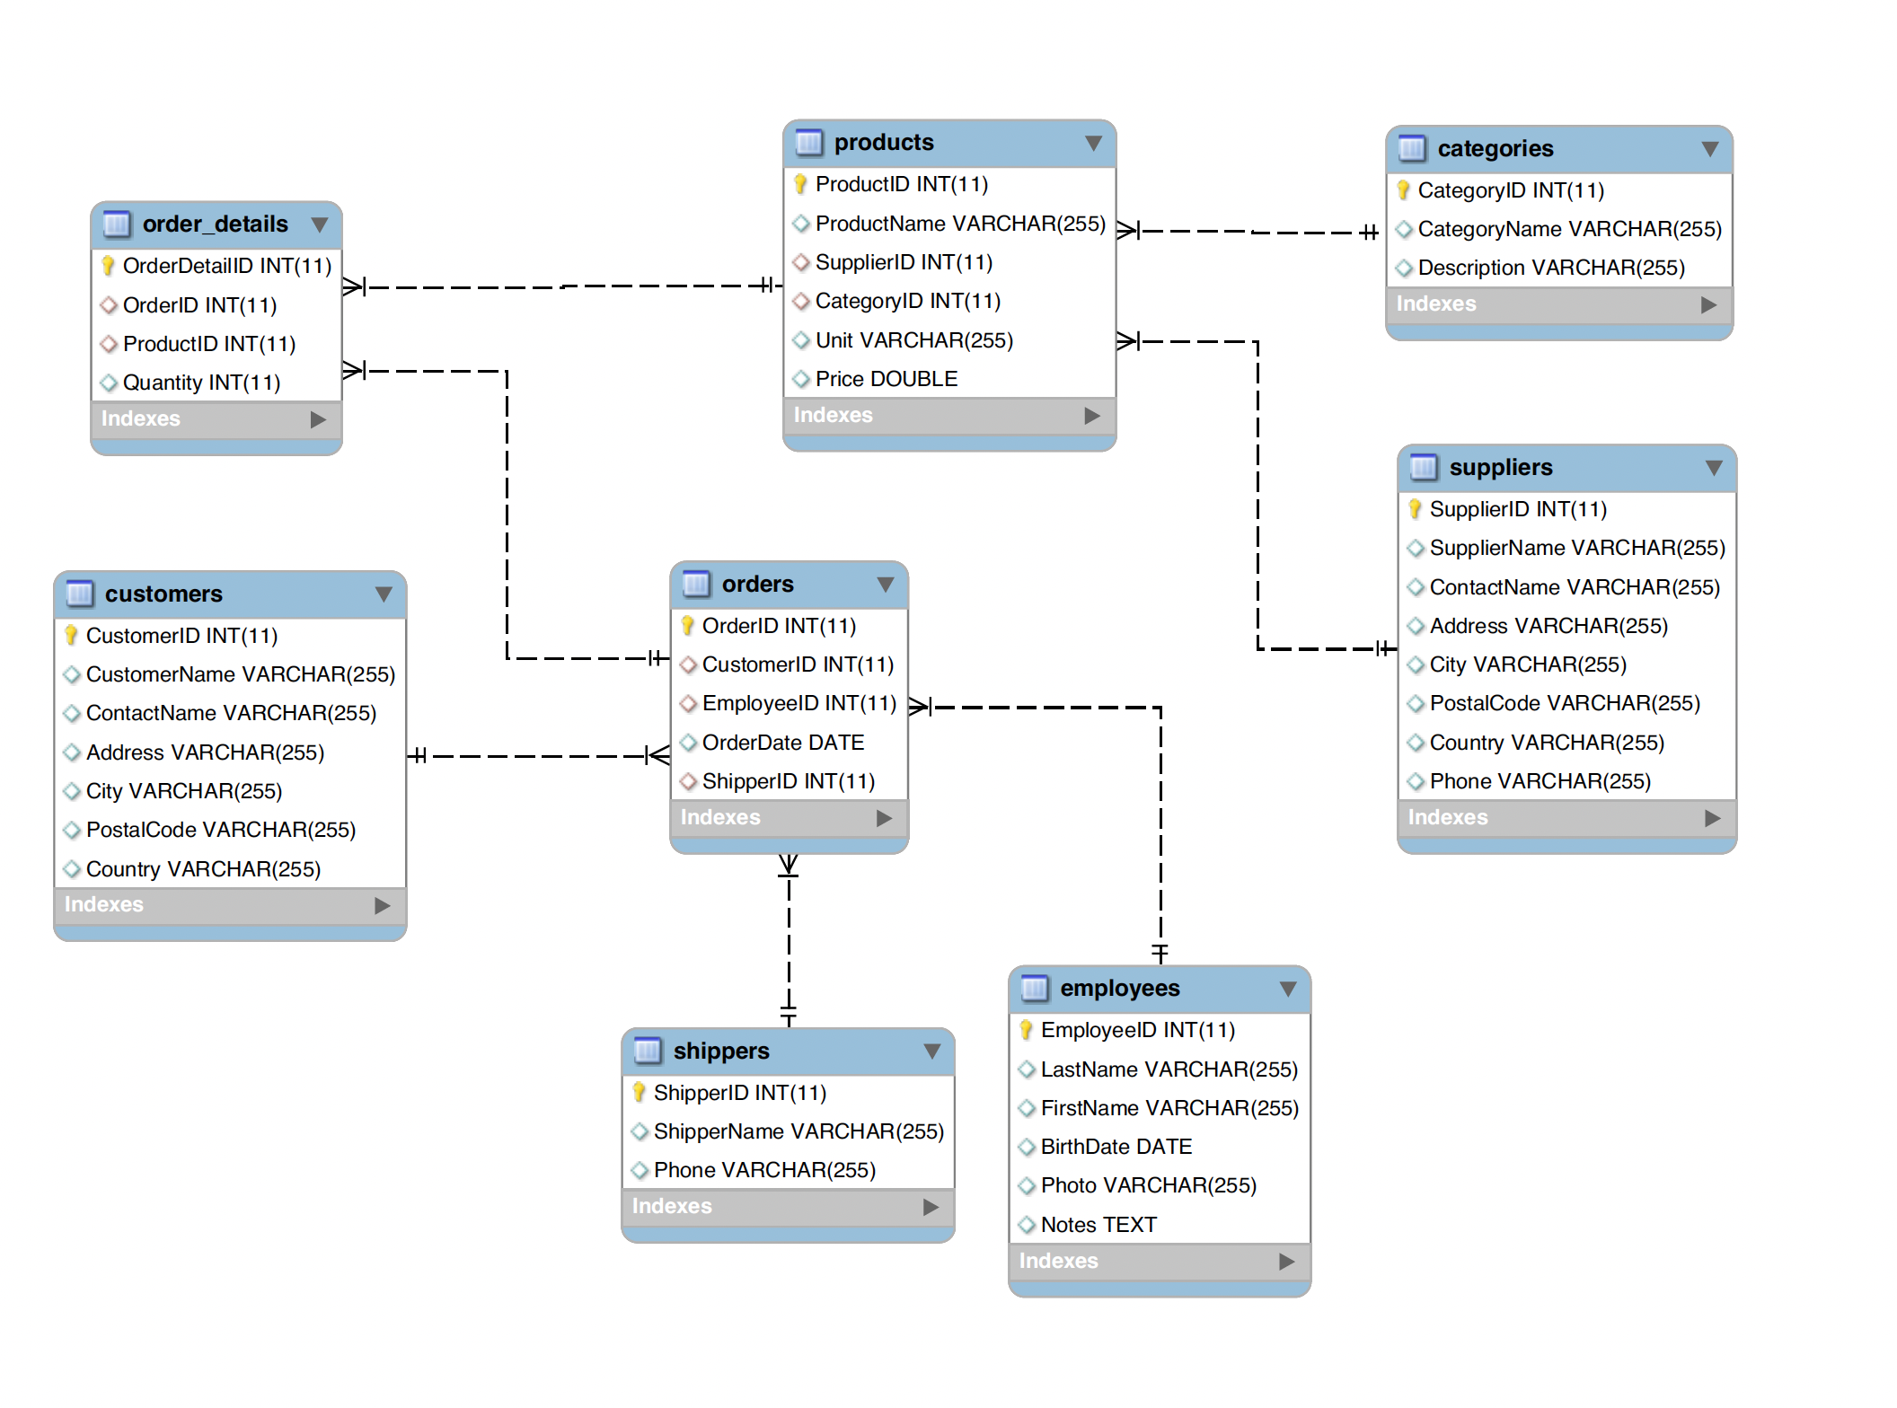
Northwind databasen

Slide 26
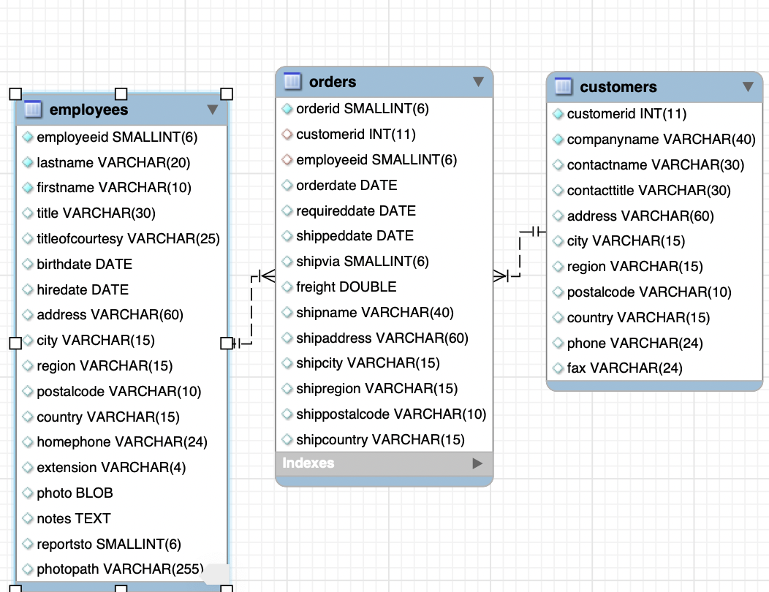
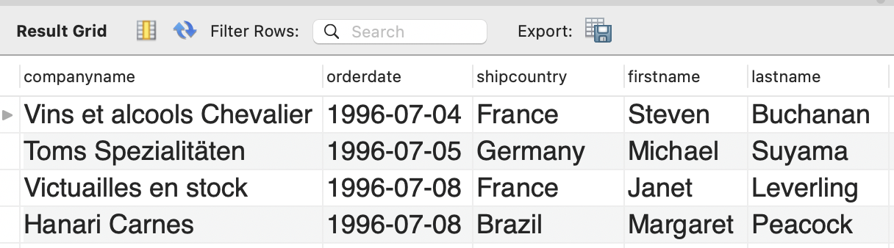
Northwind databasen – Eksempel på løsning af spørgsmål (fra video)
Hvilke medarbejdere
hjalp med handlerne?
select companyname, orderdate, shipcountry, firstname, lastname
from orders
join customers on orders.customerid=customers.customerid
join employees on orders.employeeid=employees.employeeid
order by 2;

Slide 27
Northwind databasen - øvelser
1. Show all data for the first 10 rows in the table products.
2. Show only productid, productname and unitinstock for the first 10 rows in the table products.
3. Show all data for the first 10 rows in the table products sorted by decreasing unitsinstock.
4. Show all data for the first 10 rows in the table products where unitprice is less than 10.
5. Show all data for the first 10 rows in the table products where unitsinstock is between 0 and 10.
6. Show all data for the first 10 rows in the table products where productname is geitost.
7. Show only productname, productid and discontinued for the first 10 rows in the table products where supplierid is 7 or 9.
10. Show all data for the first 10 rows in the table products where productname contains ost.
15. Show the number of rows in the table products.
16. Show the number of rows in the table products with a column name ”Number of products”.
17. Show the average of unitprice with 3 decimals in the table products with a column name ”Average price”.
18. Show all different country in the table suppliers.
20. Show the first 10 productname and companyname (for the tables products and suppliers where supplierid is equal in the two tables).
21. Show the first 10 productname and companyname as an inner join (of the tables products and suppliers where supplierid is equal in the two tables).
22. Show the three most selling employees measured in quantity .
23. Are there companies that haven’t placed any orders?

Slide 28
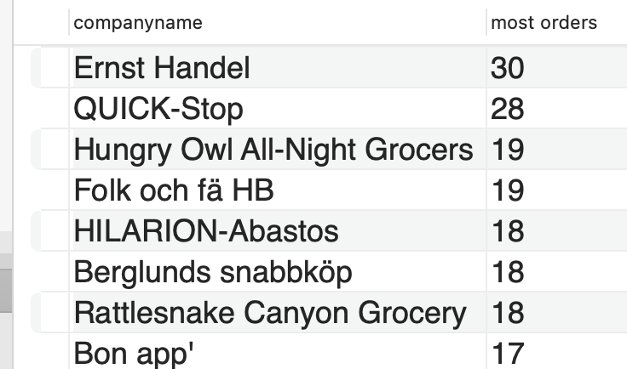
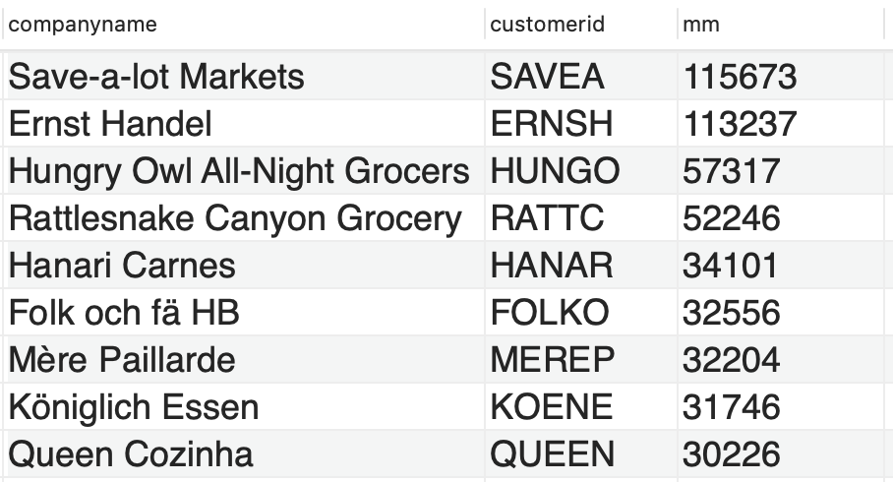
Northwind databasen
Skriv SQL til følgende spørgsmål (hvor resultatet ses til højre):
Hvilke tre kunder placerede flest ordrer?

Slide 29
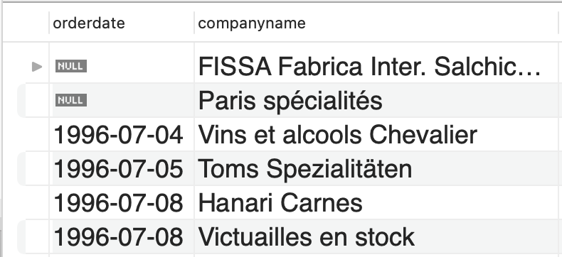
Northwind databasen
Skriv SQL til følgende spørgsmål (hvor resultatet ses til højre):
Hvilke kunder placerede ingen ordre?

Slide 30
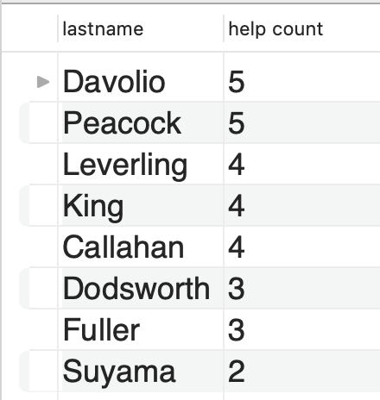
Northwind databasen
Skriv SQL til følgende spørgsmål (hvor resultatet ses til højre):
Hvilke medarbejdere hjalp ”Ernst Handel”?

Slide 31
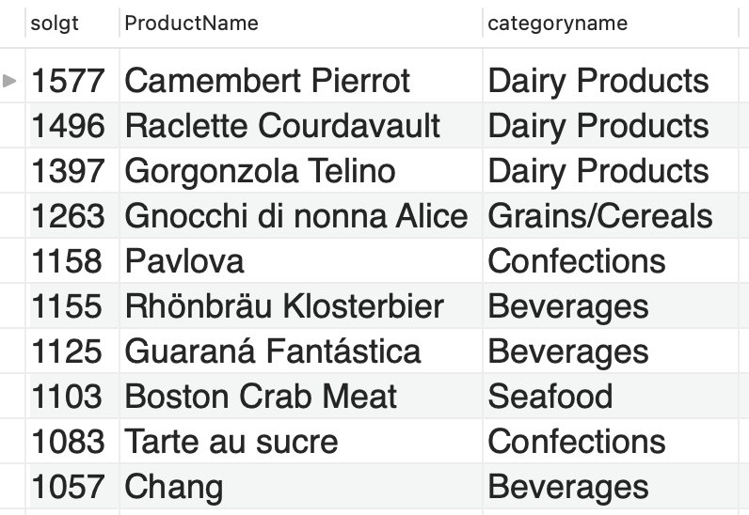
Northwind databasen
Skriv SQL til følgende spørgsmål (hvor resultatet ses til højre):
Hvilke tre produkter solgte mest
mængde
kroner

Slide 32
MySQL from R
Connecting and disconnecting
Connecting to and disconnecting from databases
dbConnect(MariaDB(), ..)
Tables
Reading and writing entire tables
dbWriteTable(con, "mycarstable”,mycarsdf)
mycardf <-dbReadTable(con, "mycarstable”)
Results
More control for sending queries and executing statements
dbGetQuery(con, "SELECT * FROM city limit 3")
req <- dbSendQuery(con ,”INSERT INTO city (Name,Population) VALUES (‘Lviv’,123123)")
rows <- dbExecute (con,”UPDATE city set Name = ‘Kurt’ WHERE id = 123”)

